Slide 1
Data Analytics with Inferential statistical analysis

Slide 2
Hypothesis Testing
State the research question.
State the statistical hypothesis.
Set decision rule.
Calculate the test statistic.
Decide if result is significant.
Interpret result as it relates to your research question.

Slide 3
Hypothesis Testing T test Z-test Chi Squared Test Anova test

Slide 4
T Test The One-Sample t-Test Dependent Samples t-Test Independent Samples t-Test

Slide 5
When to use the one-sample t-test
One of the most difficult aspects of statistics is determining which procedure to use in what situation.
Mostly this is a matter of practice.
There are many different rules of thumb which may be of some help.
In practice, however, the more you understand the meaning behind each of the techniques, the more the choice will become obvious.

Slide 6
Example
Example illustrates the calculation of the one-sample t-test.
This test is used to compare a list of values to a set standard.
What is this standard?
The standard is any number we choose.
As illustrated next, the standard is usually chosen for its theoretical or practical importance.

Slide 7
Example (cont.)
Intelligence tests are constructed such that the average score among adults is 100 points.
In this example, we take a small sample of undergraduate students at a University (N = 6), and try to determine if the average of intelligence scores for all students at the university is higher than 100.
In simple terms, are the university students smarter than average?

Slide 8
Example(cont.)
The scores obtained from the 6 students were as follows:
X
Person 1: 110
Person 2: 118
Person 3: 110
Person 4: 122
Person 5: 110
Person 6: 150

Slide 9
Example(cont.)
Research Question
On average, do the population of undergraduates at a University have higher than average intelligence scores (IQ > 100)?

Slide 10
Example(cont.)
First, we must compute the mean (or average) of this sample:
=

Slide 11
Example(cont.)
=
First, a symbol that denotes the mean of all Xs or intelligence scores.

Slide 12
Example(cont.)
=
The second part of the equation shows how this quantity is computed.

Slide 13
Example (cont.)
=
The sigma symbol ( ∑ ) tells us to sum all the individual Xs.

Slide 14
Example (cont.)
=
Lastly, we must divide by ‘n’,
that is: the number of observations.

Slide 15
Example (cont.)
=
Notice, these 6 people have higher than average intelligence scores (IQ > 100).

Slide 16
Example (cont.)
However, is this finding likely to hold true in repeated samples?
What if we drew 6 different people from the University?
A one-sample t-test will help answer this question.
It will tell us if our findings are ‘significant’, or in other words, likely to be repeated if we took another sample.

Slide 17
Example (cont.) Computing the sample variance
110 118 110 122 110 150 | 120 120 120 120 120 120 | -10 - 2 -10 2 -10 30 | 100 4 100 4 100 900

Slide 18
Example (cont.) Computing the sample variance
110 118 110 122 110 150 | 120 120 120 120 120 120 | -10 - 2 -10 2 -10 30 | 100 4 100 4 100 900

Slide 19
Example (cont.) Computing the sample variance
To get the third column we take each individual ‘X’ and subtract it from the mean (120).
We square each result to get the fourth column.
Next, we simply add up the entire fourth column and divide by our original sample size (n = 6).
The resulting figure, 201.3, is the sample variance.

Slide 20
Example (cont.) Computing the sample variance
Important:
All sample variances are computed this way!
We always take the mean; subtract each score from the mean; square the result; sum the squares; and divide by the sample size (how many numbers, or rows we have).

Slide 21
Example (cont.) Computing the sample variance
Now that we have the mean (X = 120) and the variance of our sample, we have everything needed to compute whether the sample mean is ‘significantly’ above the average intelligence.
In the formula that follows, we use a new symbol mu ( μ ) to indicate the population standard value ( μ = 100 ) against which we compare our obtained score (X = 120).

Slide 22
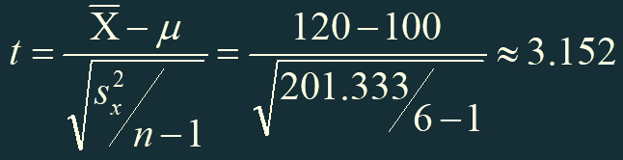
Example (cont.) Computing the sample variance
Our sample has ‘n = 6’ people, so the degrees of freedom for this t-test are:
dn = n – 1 = 5
This degrees of freedom figure will be used later in our test of significance.

Slide 23

And now for something completely different …
Let’s take a break from computations, and talk about ‘the big picture’
Now comes the conceptually tricky part.
Remember that a normal bell-curve distribution is a chart that shows frequencies (or counts).
If we measured the weight of four male adults, for example, we might find the following:
Person 1 = 70 kg, Person 2 = 75 kg, Person 3 = 70 kg, Person 4 = 65 kg

Slide 24
The ‘big picture’
Person 1 = 70 kg, Person 2 = 75 kg, Person 3 = 70 kg, Person 4 = 65 kg
Plotting a count of these ‘weight’ data, we find a normal distribution:
Count 2 X
1 X X X
65 70 75 kg

Slide 25
The ‘big picture’ (cont.)
As it turns out, the ‘t’ statistic has its own distribution, just like any other variable.
Let’s assume, for the moment, that the mean IQ of the population in our example is exactly 100.
If we repeatedly sampled 6 people and calculated a ‘t’ statistic each time, what would we find?
If we did this 4 times, for example, we might find:
Count 2 X
1 X X X
- 1 0 1 t - statistic

Slide 26

The ‘t’ statistic (cont.)
Most often our computed ‘t’ should be around 0. Why? Because the numerator, or top part of the formula for t is: .
If our first sample of 6 people is truly representative of the population, then our sample mean should also be 100, and therefore our computed t should be → (see next slide)

Slide 27
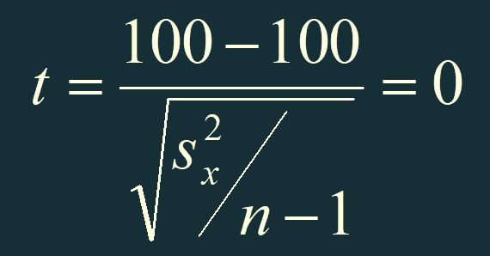
The ‘t’ statistic (cont.)

Slide 28
The ‘t’ statistic (cont.)
Of course, our repeated samples of 6 people will not always have exactly the same mean as the population.
Sometimes it will be a little higher, and sometimes a little lower.
The frequency with which we find a t larger than 0 (or smaller than 0) is exactly what the t-distribution is meant to represent → (see next slide)

Slide 29
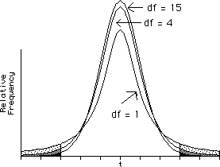
The ‘t’ statistic (cont.)

Slide 30
And now, back to the computation…
We need to find the ‘critical value’ of our t-test.
Looking in the back of any statistics textbook, you can find a table for critical values of the t-distribution.
Next, we need to determine whether we are conducting a 1-tailed or 2-tailed t-test.
Let’s refer back to the research question:

Slide 31
Example (again)
Research Question
On average, do the population of undergraduates at University have higher than average intelligence scores (IQ > 100)?

Slide 32
Example (cont.)
This is a 1-tailed test, because we are asking if the population mean is ‘greater’ than 100.
If we had only asked whether the intelligence of students were ‘different’ from average (either higher or lower) then the test would be 2-tailed.
In the appendixes of your textbook, look at the table titled, ‘critical values of the t-distribution’.
Under a 1-tailed test with an Alfa-level of and degrees of freedom df = 5, and you should find a critical value (C.V.) of t = 2.02.

Slide 33
Example (cont.)
Is our computed t = 3.152 greater than the C.V. = 2.02?
Yes!
Thus we reject the null hypothesis and live happily ever after.
Right?
Not so fast. What does this really mean?

Slide 34
Example (still)
We assume the null hypothesis when making this test.
We assume that the population mean is 100, and therefore we will most often compute a t = 0.
Sometimes the computed ‘t’ might be a bit higher and sometimes a bit lower.

Slide 35
What does the ‘critical value’ tell us?
Based on knowledge of the distribution table we know that 95% of the time, in repeated samples, the computed ‘t’ statistics should be less than 2.02.
That’s what the critical value tells us.
It says that when we are sampling 6 persons from a population with mean intelligence scores of 100, we should rarely compute a ‘t’ higher than 2.02.

Slide 36
What happens if we do calculate a ‘t’ greater than 2.02?
Well, we can be pretty confident that our sample does not come from a population with a mean of 100!
In fact, we can conclude that the population mean intelligence must be higher than 100.
How often will we be wrong in this conclusion?
If we do these t-tests a lot, we’ll be wrong 5% of the time. That’s the Alfa level (or 5%).

Slide 37
Statistical inference
You should notice that the conclusion makes an inference about the population of students from the University based on a small sample.
This is why we call this type of a test ‘statistical inference.’
We are inferring something about the population based on only a sample of members.

Slide 38
T-test for dependent Samples

Slide 39
The t Test for Dependent Samples
Repeated-Measures Design
When you have two sets of scores from the same person in your sample, you have a repeated-measures, or within-subjects design.
You are more similar to yourself than you are to other people.

Slide 40
Difference Scores
The way to handle two scores per person, or a matched pair, is to make difference scores.
For each person, or each pair, you subtract one score from the other.
Once you have a difference score for each person, or pair, in the study, you treat the study as if there were a single sample of scores (scores that in this situation happen to be difference scores).

Slide 41
A Population of Difference Scores with a Mean of 0
The null hypothesis in a repeated-measures design is that on the average there is no difference between the two groups of scores.
This is the same as saying that the mean of the sampling distribution of difference scores is 0.

Slide 42
The t Test for Dependent Samples
You do a t test for dependent samples the same way you do a t test for a single sample, except that:
You use difference scores.
You assume the population mean is 0.

Slide 43
The t Test for Dependent Samples

Slide 44
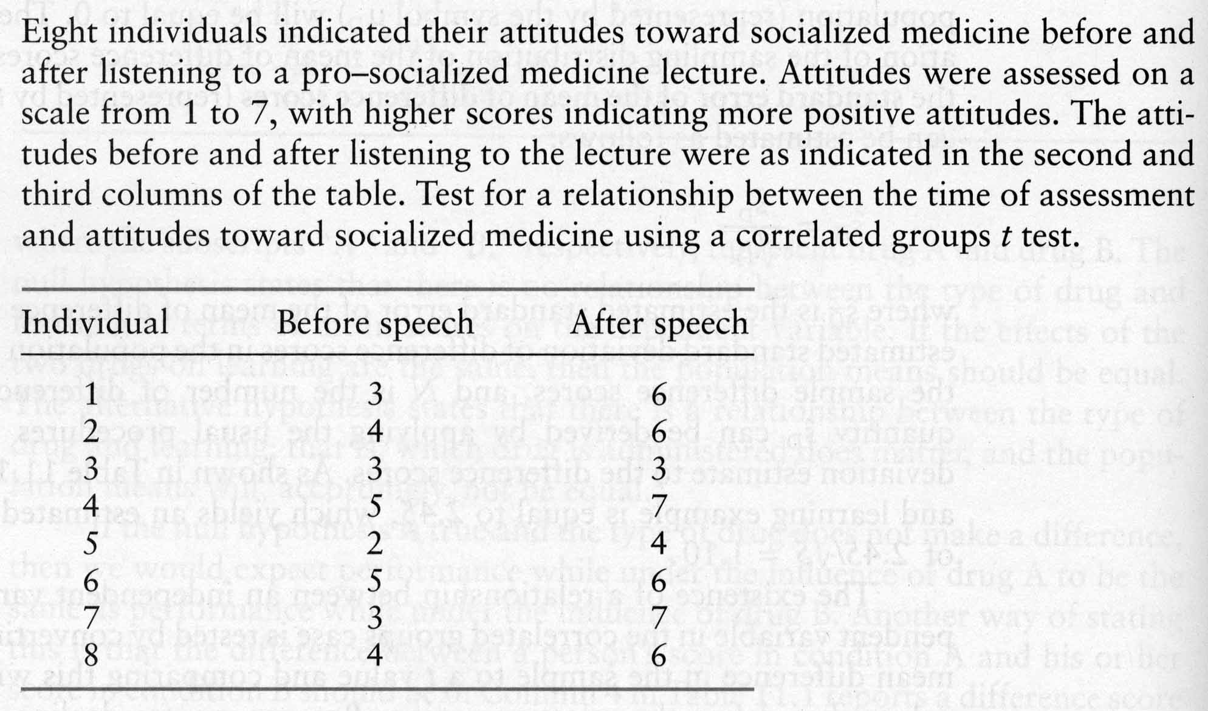
The t Test for Dependent Samples: An Example

Slide 45
The t Test for Dependent Samples: An Example
State the research hypothesis.
Does listening to a pro-socialized medicine lecture change an individual’s attitude toward socialized medicine?
State the statistical hypotheses.

Slide 46
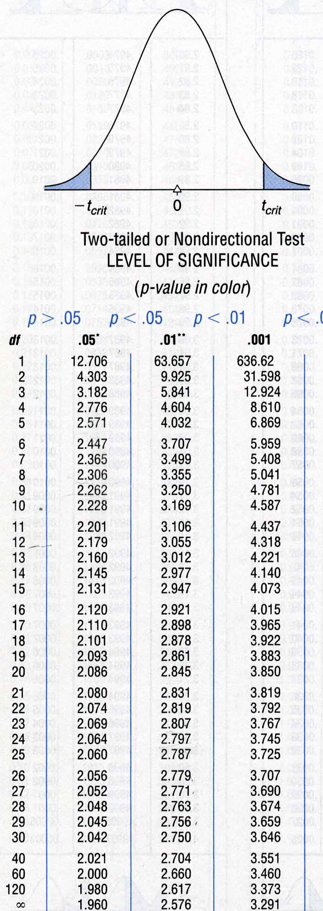
The t Test for Dependent Samples: An Example
Set the decision rule.

Slide 47
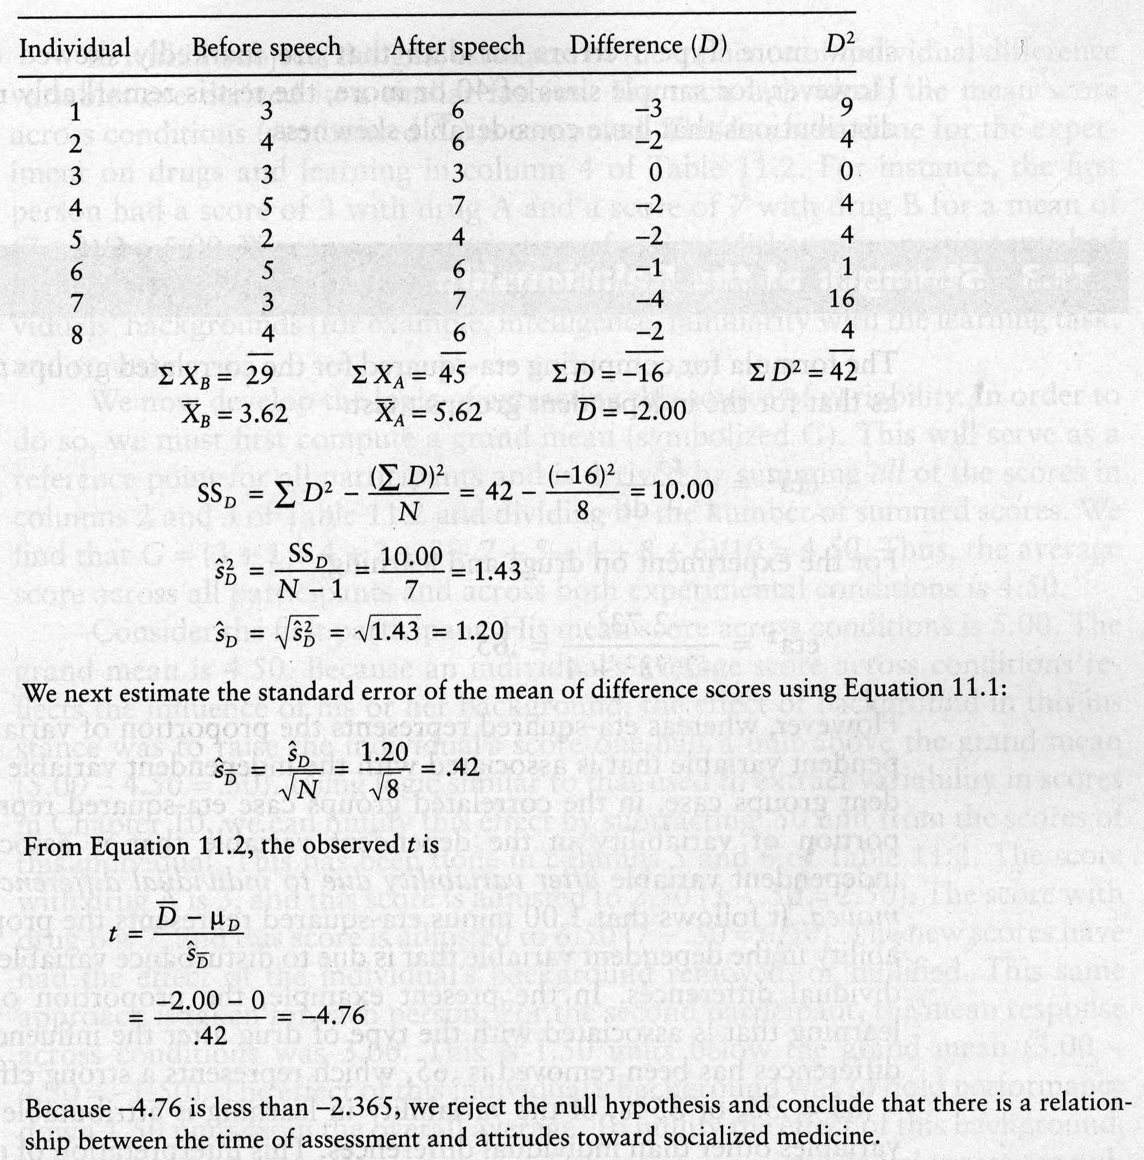
The t Test for Dependent Samples: An Example
Calculate the test statistic.

Slide 48
The t Test for Dependent Samples: An Example
Decide if your results are significant.
Reject H0, -4.76<-2.365
Interpret your results.
After the pro-socialized medicine lecture, individuals’ attitudes toward socialized medicine were significantly more positive than before the lecture.

Slide 49
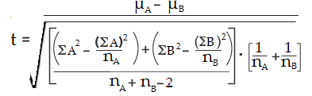
T-test for independent Samples
Example: Calculate an independent samples t test for the following data sets: Data set A: 1,2,2,3,3,4,4,5,5,6 Data set B: 1,2,4,5,5,5,6,6,7,9
Step 1: Sum the two groups: A: 1 + 2 + 2 + 3 + 3 + 4 + 4 + 5 + 5 + 6 = 35 B: 1 + 2 + 4 + 5 + 5 + 5 + 6 + 6 + 7 + 9 = 50
Step 2: Square the sums from Step 1: 35² = 1225 49² = 2500 Set these numbers aside for a moment.
Step 3: Calculate the means for the two groups: A: (1 + 2 + 2 + 3 + 3 + 4 + 4 + 5 + 5 + 6)/10 = 35/10 = 3.5 B: (1 + 2 + 4 + 5 + 5 + 5 + 6 + 6 + 7 + 9) = 50/10 = 5 Set these numbers aside for a moment.
Step 4: Square the individual scores and then add them up: A: 1¹ + 2² + 2² + 3³ + 3³ + 4⁴ + 4⁴ + 5⁵ + 5⁵ + 6⁶ = 145 B: 1² + 2² + 4⁴ + 5⁵ + 5⁵ + 5⁵ + 6⁶ + 6⁶ + 7⁷ + 9⁹ = 298 Set these numbers aside for a moment.
Step 5: Insert your numbers into the following formula and solve:
ΣA)²: Sum of data set A, squared (Step 2). (ΣB)²: Sum of data set B, squared (Step 2). μ_{A}: Mean of data set A (Step 3) μ_{B}: Mean of data set B (Step 3) ΣA²: Sum of the squares of data set A (Step 4) ΣB²: Sum of the squares of data set B (Step 4) n^{A}: Number of items in data set A n^{B}: Number of items in data set B

Slide 50
Example (Conti..)
Step 6: Find the Degrees of freedom (n_{A}-1 + n_{B}-1) = 18
Step 7: Look up your degrees of freedom (Step 6) in the t-table. If you don’t know what your alpha level is, use 5% (0.05). 18 degrees of freedom at an alpha level of 0.05 = 2.10.
Step 8: Compare your calculated value (Step 5) to your table value (Step 7). The calculated value of -1.79 is less than the cutoff of 2.10 from the table. Therefore p > .05. As the p-value is greater than the alpha level, we cannot conclude that there is a difference between means.

Slide 51
The t Test for Independent Samples
Observations in each sample are independent (not from the same population) each other.
We want to compare differences between sample means.

Slide 52
Sampling Distribution of the Difference Between Means
Imagine two sampling distributions of the mean...
And then subtracting one from the other…
If you create a sampling distribution of the difference between the means…
Given the null hypothesis, we expect the mean of the sampling distribution of differences, μ1- μ2, to be 0.
We must estimate the standard deviation of the sampling distribution of the difference between means.

Slide 53
Estimating Standard Error of the Difference Between Means

Slide 54
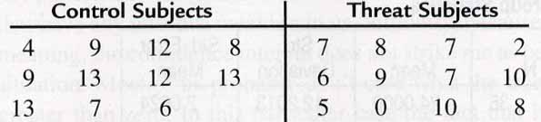
The t Test for Independent Samples: An Example
Stereotype Threat
“Trying to develop the test itself.”
“This test is a measure of your academic ability.”

Slide 55
The t Test for Independent Samples: An Example
State the research question.
Does stereotype threat hinder the performance of those individuals to which it is applied?
State the statistical hypotheses.

Slide 56
The t Test for Independent Samples: An Example
Set the decision rule.

Slide 57
The t Test for Independent Samples: An Example
Calculate the test statistic.

Slide 58
The t Test for Independent Samples: An Example
Calculate the test statistic.

Slide 59
The t Test for Independent Samples: An Example
Calculate the test statistic.

Slide 60
The t Test for Independent Samples: An Example
Decide if your result is significant.
Reject H0, - 2.37< - 1.721
Interpret your results.
Stereotype threat significantly reduced performance of those to whom it was applied.

Slide 61
Chi-Squared Tests
Sometimes we need to compare the sample distribution to the predicted distribution
A gambler observes throws of a die to determine if the die is fair
After observing 48 throws, he has the following observations
Is the die fair?
Spots | Observed Frequency
1 | 8
2 | 7
3 | 2
4 | 14
5 | 10
6 | 7

Slide 62
Chi-Squared Tests
In this case, we are comparing the observations against the null hypothesis that each outcome is equally likely
In 48 throws, we would expect to see 8 of each value come up
Spots | Expected Frequency
1 | 8
2 | 8
3 | 8
4 | 8
5 | 8
6 | 8

Slide 63
Chi-Squared Tests
To get an idea of how far off each observed frequency (OF) is from the expected frequency (EF), we calculate the following for each possible value in the distribution
By summing up these values, we obtain the ² (chi-square) statistic
For the die example,

Slide 64
Chi-Squared Tests
Once we have the ² statistic, we can look it up in a ² table with m degrees of freedom
The degrees of freedom will be the number of values in the distribution – 1 in this context

Slide 65
Chi-Squared Tests
Since there are six possible values in the die-rolling distribution, there are 6 – 1 = 5 degrees of freedom in the ² distribution
Look up the ² value of 9.75 in the row for 5 degrees of freedom
The table tells us that the P-value is between 5% and 10%, so the result is not statistically significant
However, the rolls came heavy on 4 and light on 3
3 and 4 are on opposite sides of the die
Perhaps it would be good to observe more throws and retest

Slide 66
Chi-Squared Tests
A programmer designing a random number generator needs to ensure that the numbers are uniformly distributed between 0 and 1
“Uniformly distributed” means that each number between 0 and 1 is equally likely to be generated
She generates 1,000 numbers and groups them into class intervals based on their first digit after the decimal

Slide 67
Chi-Squared Tests
The results are shown in the table
Are the numbers close enough to uniform, or should the programmer adjust the generator?
First Decimal | Observed Frequency
0 | 98
1 | 115
2 | 84
3 | 67
4 | 126
5 | 100
6 | 170
7 | 94
8 | 98
9 | 48
Use a ² test with 9 degrees of freedom. ² = 98.94, P  0%. The generator is certainly not uniform.

Slide 68
Chi-Squared Tests
Another use for the ² test is to determine if two variables are independent
If two variables are independent, then the distribution of one variable under the other should look the same
The ² test tells us if two distributions look the same
 | 18-24 | 25-34 | 35-44 | 45 and over
Inpatients | 230 | 415 | 330 | 181
Outpatients | 530 | 1198 | 888 | 391

Slide 69
Chi-Squared Tests
To calculate the expected frequencies in a block,
Find the proportion of cases of all the variables in that row compared to the total number of cases in the table
Multiply this by the total number of cases in that column

Slide 70
Chi-Squared Tests
Observed | 18-24 | 25-34 | 35-44 | 45 and over
Inpatients | 230 | 415 | 330 | 181
Outpatients | 530 | 1198 | 888 | 391
Total = 1156
Total = 3007
Total = 760
Total = 1613
Total = 1218
Total = 572
Grand total = 4163
(1156/4163)(760)  211
Expected | 18-24 | 25-34 | 35-44 | 45 and over
Inpatients | 211
Outpatients

Slide 71
Chi-Squared Tests
Observed | 18-24 | 25-34 | 35-44 | 45 and over
Inpatients | 230 | 415 | 330 | 181
Outpatients | 530 | 1198 | 888 | 391
Total = 1156
Total = 3007
Total = 760
Total = 1613
Total = 1218
Total = 572
Grand total = 4163
(1156/4163)(1613)  448
Expected | 18-24 | 25-34 | 35-44 | 45 and over
Inpatients | 211 | 448
Outpatients

Slide 72
Chi-Squared Tests
Observed | 18-24 | 25-34 | 35-44 | 45 and over
Inpatients | 230 | 415 | 330 | 181
Outpatients | 530 | 1198 | 888 | 391
Total = 1156
Total = 3007
Total = 760
Total = 1613
Total = 1218
Total = 572
Grand total = 4163
Expected | 18-24 | 25-34 | 35-44 | 45 and over
Inpatients | 211 | 448 | 338 | 159
Outpatients | 549 | 1165 | 880 | 413

Slide 73
Chi-Squared Tests
To find how far off each observed case is from the expected case, use the formula
To get the value of ², add up all of these terms
In this case,

Slide 74
Chi-Squared Tests
The number of degrees of freedom will be (number of rows – 1)(number of columns – 1)
In this case, there are (4 – 1)(2 – 1) = 3 degrees of freedom
The last step is to estimate the P-value by finding the range in the table which covers ² = 14.3 for 3 degrees of freedom
The table tells us P < 1%, meaning that we can say the variables are not independent

Slide 75
Z-Test: When Population Variance is Known
Example
Boys of a certain age are known to have a mean weight of μ = 85 pounds. A complaint is made that the boys living in a municipal children's home are underfed. As one bit of evidence, n = 25 boys (of the same age) are weighed and found to have a mean weight of x¯ = 80.94 pounds. It is known that the population standard deviation σ is 11.6 pounds (the unrealistic part of this example!). Based on the available data, what should be concluded concerning the complaint?

Slide 76

Solution
The null hypothesis is H₀: μ = 85, and the alternative hypothesis is H_{A}: μ < 85. In general, we know that if the weights are normally distributed, then:
follows the standard normal N(0,1) distribution. It is actually a bit irrelevant here whether or not the weights are normally distributed, because the same size n = 25 is large enough for the Central Limit Theorem to apply. In that case, we know that Z, as defined above, follows at least approximately the standard normal distribution. At any rate, it seems reasonable to use the test statistic:

Slide 77

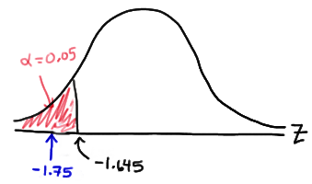
For the example in hand, the value of the test statistic is:
The critical region approach tells us to reject the null hypothesis at the α = 0.05 level if Z < −1.645. Therefore, we reject the null hypothesis because Z = −1.75 < −1.645, and therefore falls in the rejection region:

Slide 78
References
http://psychologyaustralia.homestead.com
http://cstl-hhs.semo.edu
http://wps.prenhall.com
http://www.math.unt.edu/~yweng
http://psychology.illinoisstate.edu
http://www.pitt.edu

